Slide 1
TR58 Calibration Data

Slide 2
TR58 Home calibrations pre-TMR PR 8-week home trial

Slide 3
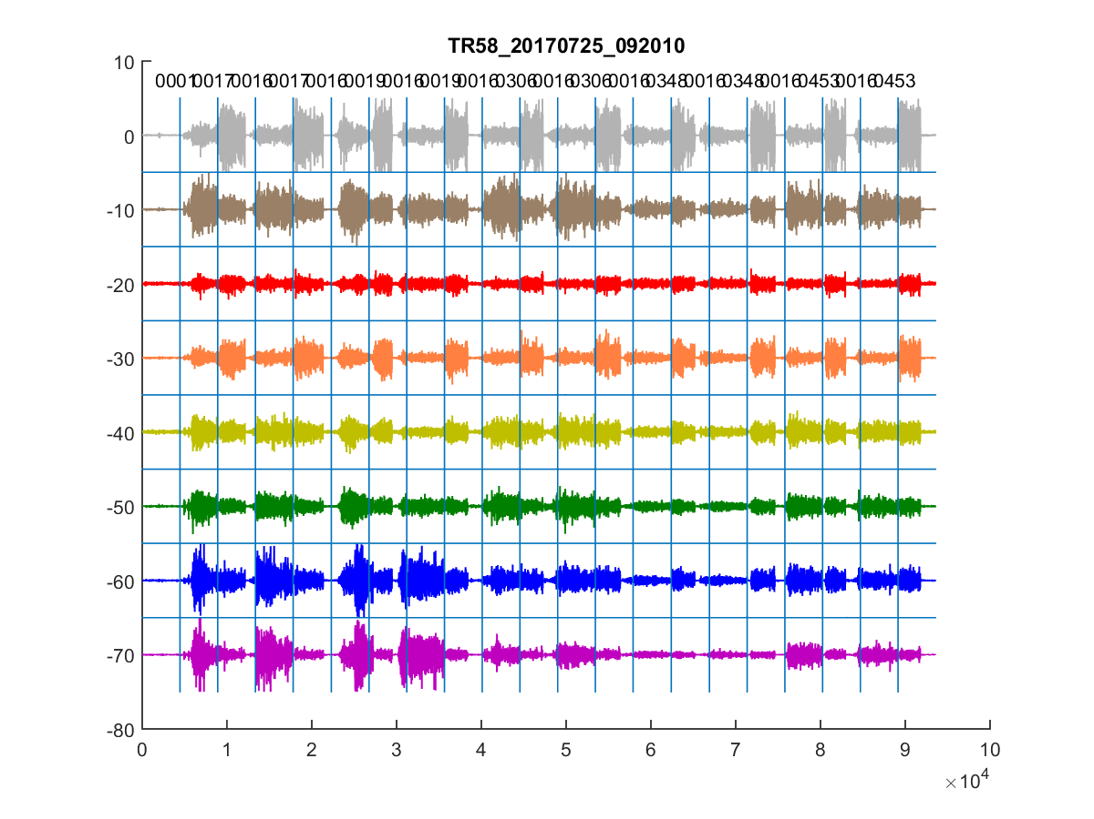
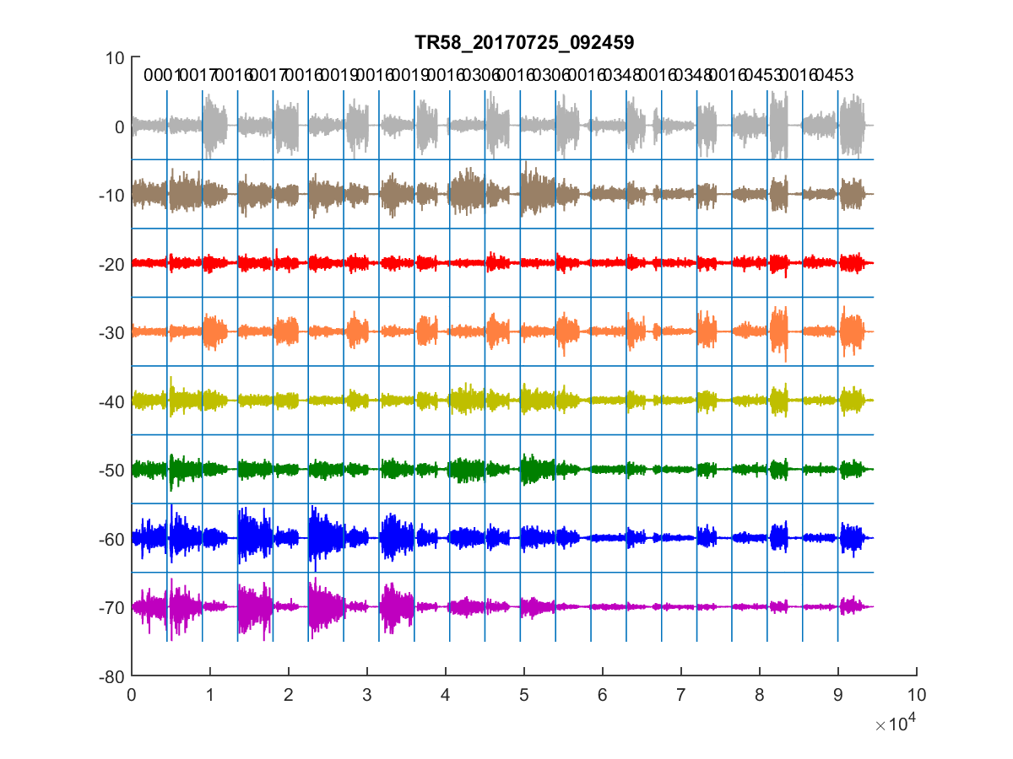
pre-TMR PR training

Slide 4
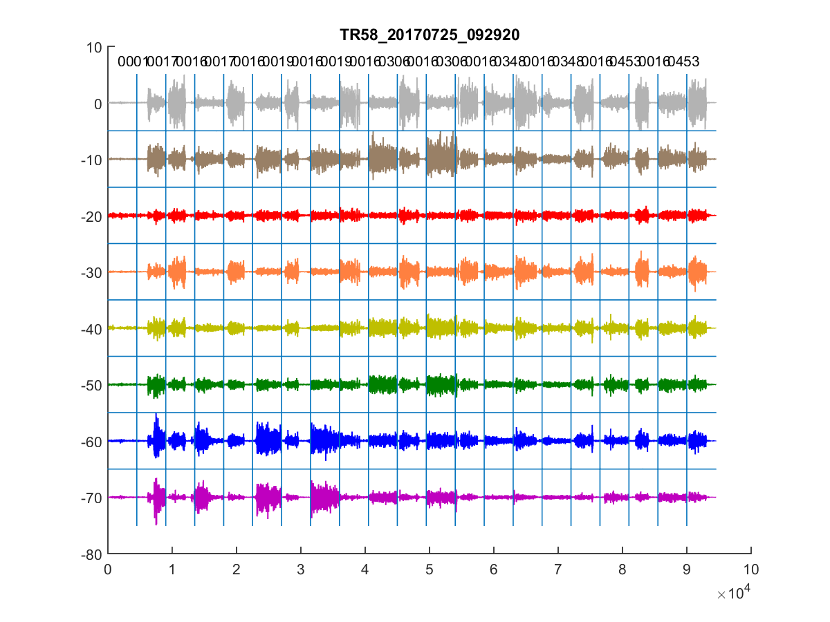
pre-TMR PR training

Slide 5
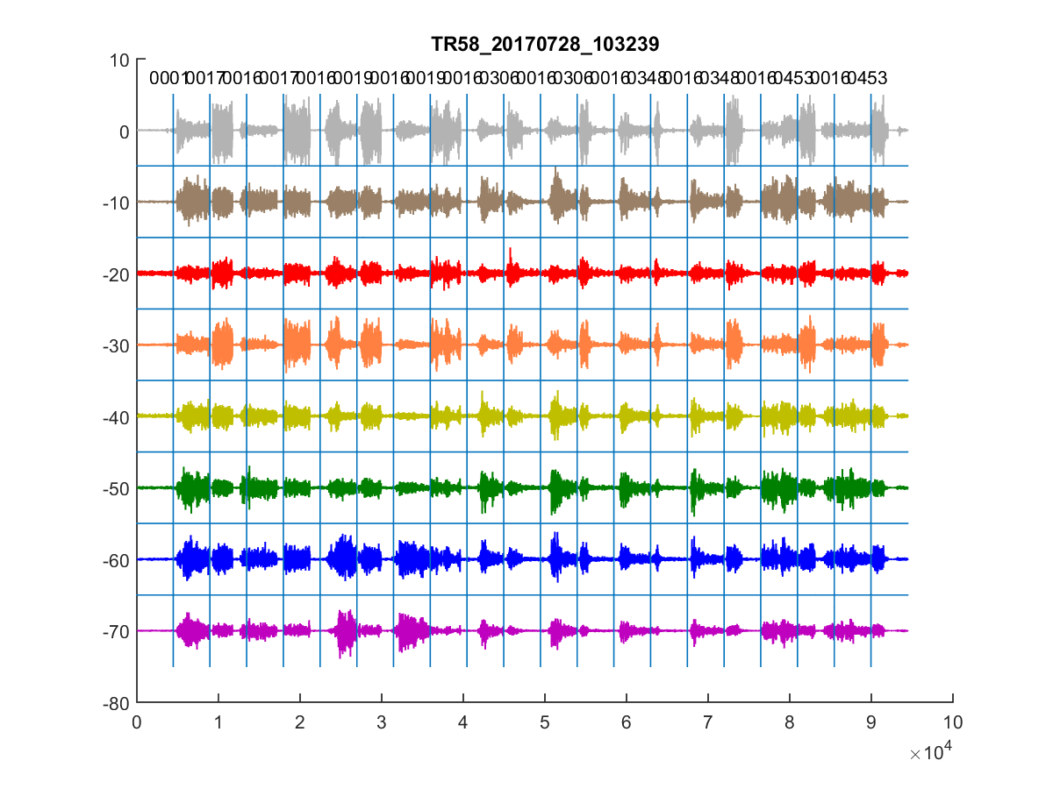
pre-TMR PR 8-week home trial

Slide 6
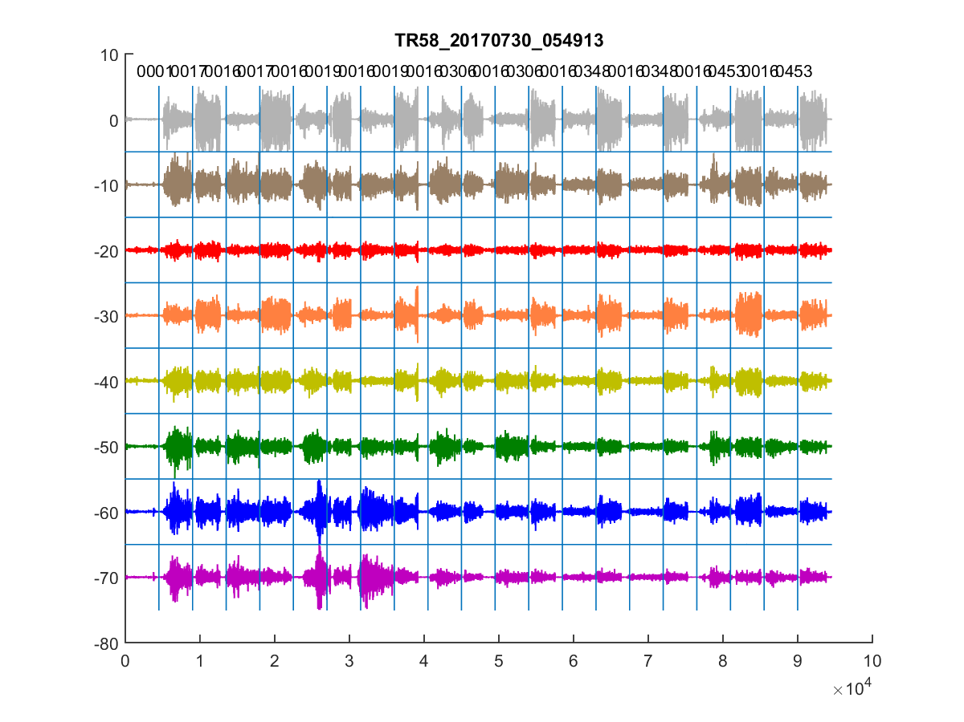
pre-TMR PR 8-week home trial

Slide 7
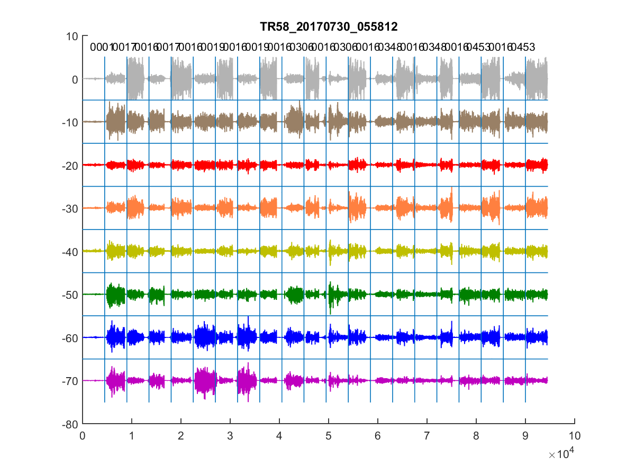
pre-TMR PR 8-week home trial

Slide 8
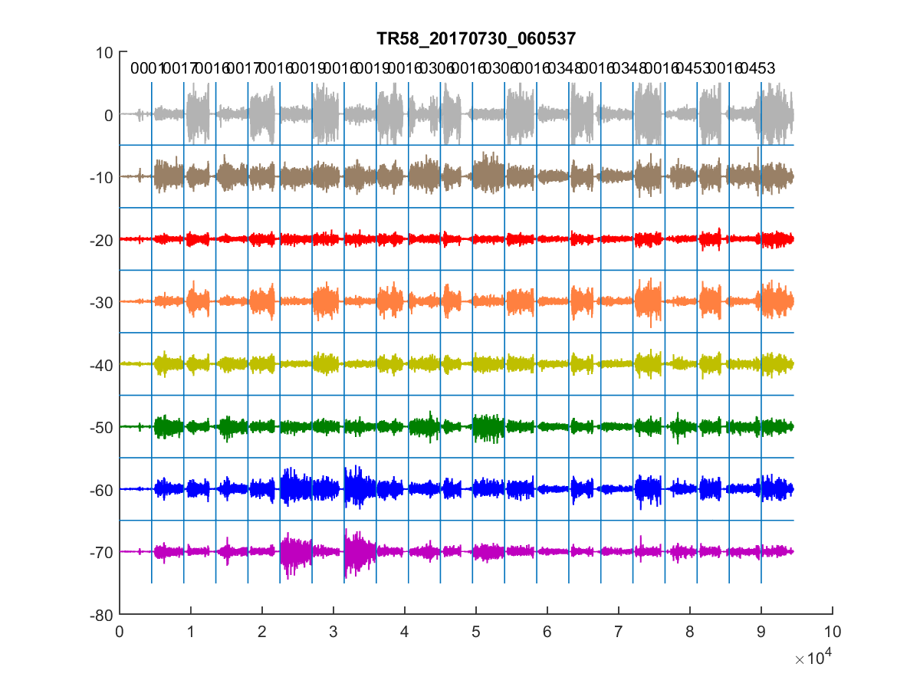
pre-TMR PR 8-week home trial

Slide 9
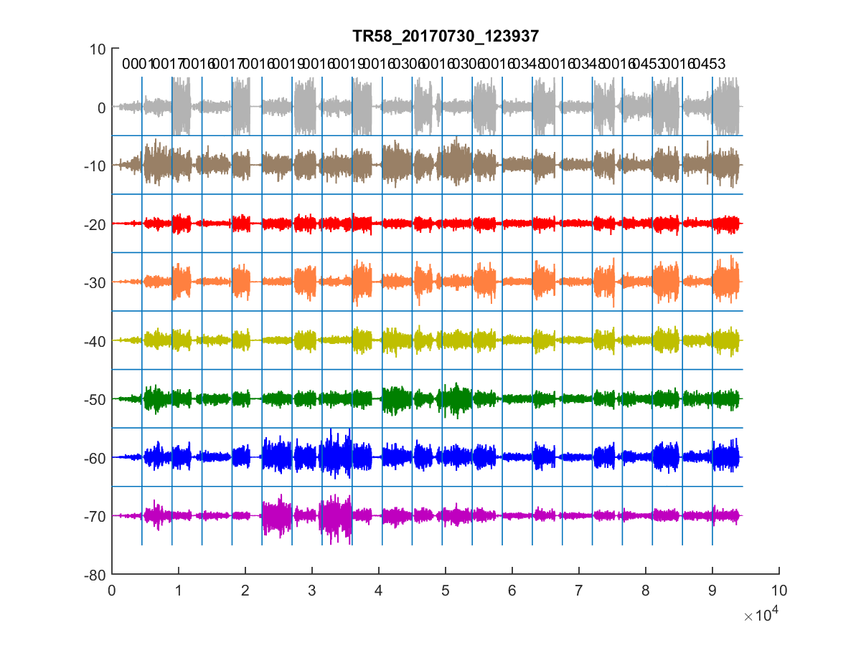
pre-TMR PR 8-week home trial

Slide 10
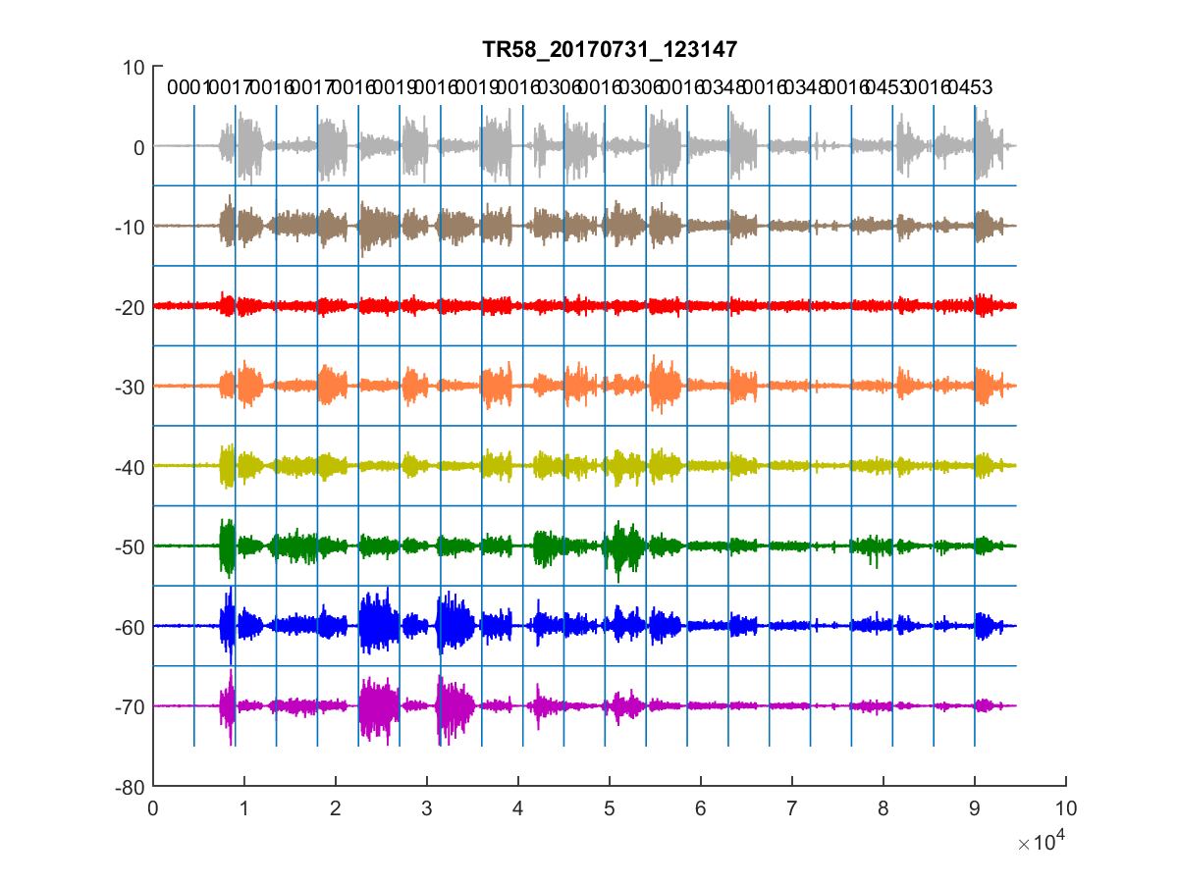
pre-TMR PR 8-week home trial

Slide 11
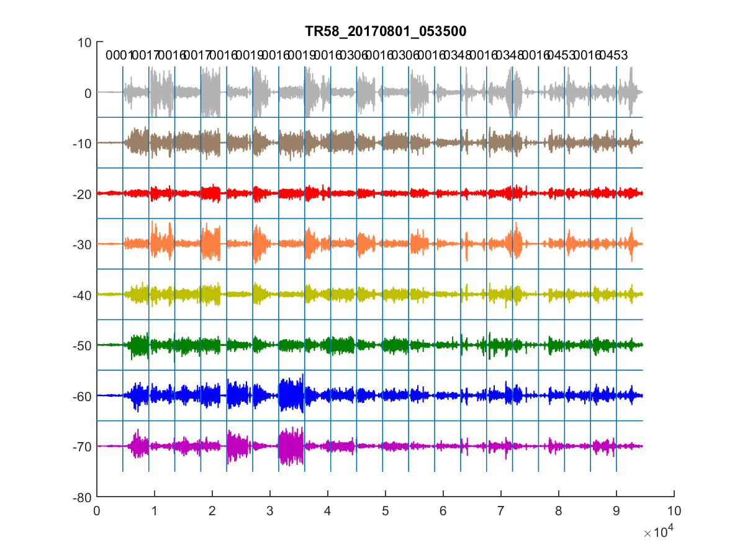
pre-TMR PR 8-week home trial

Slide 12
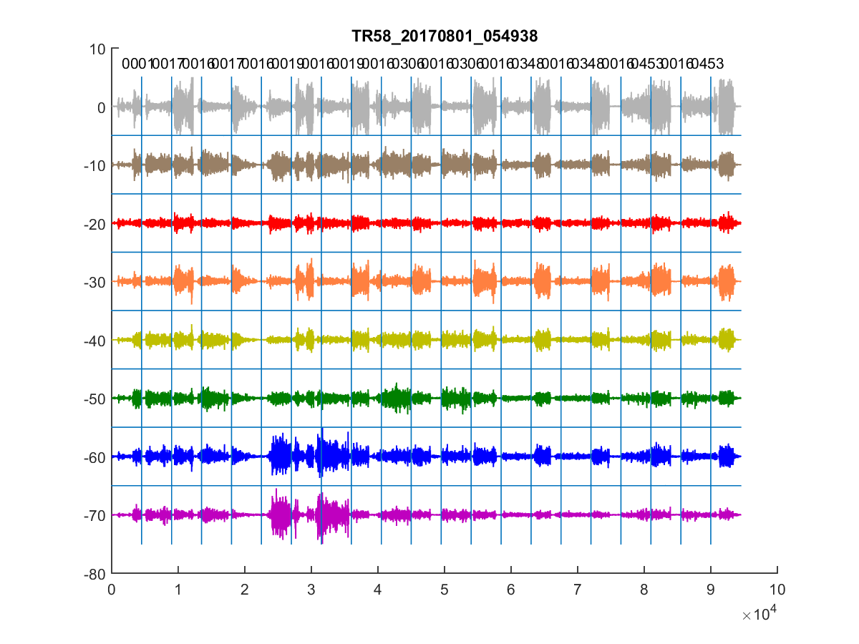
pre-TMR PR 8-week home trial

Slide 13
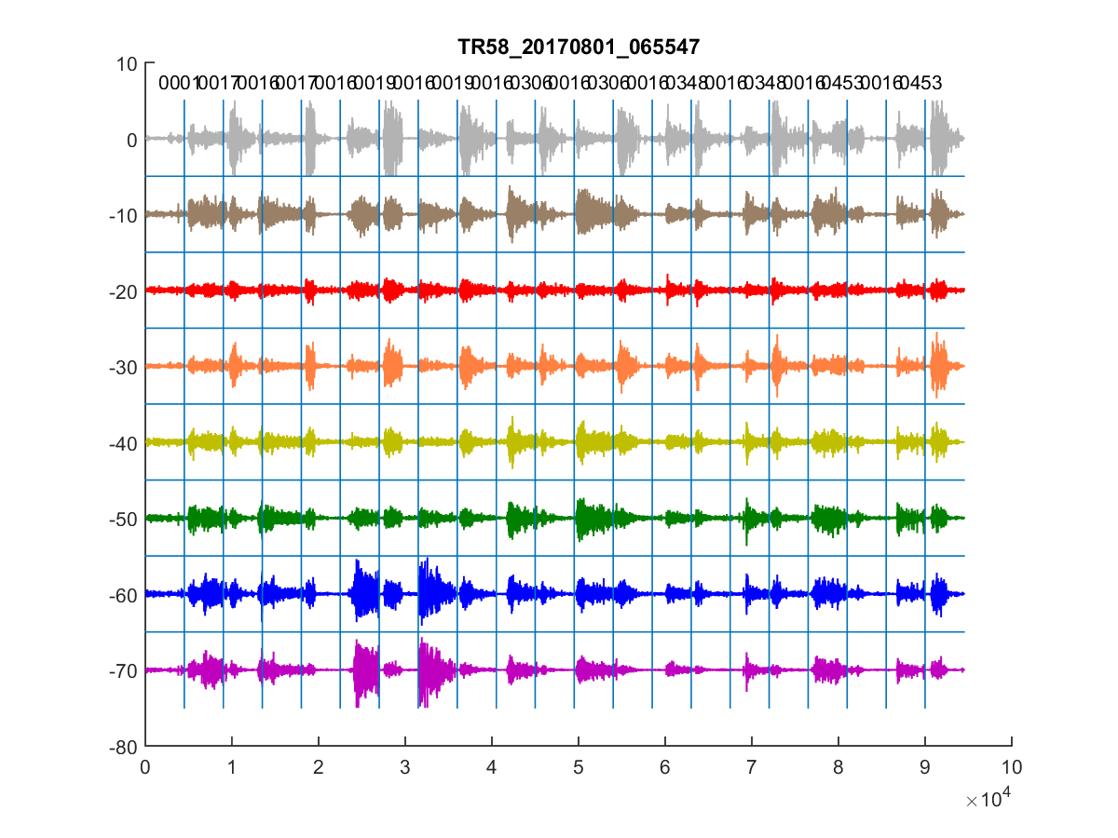
pre-TMR PR 8-week home trial

Slide 14
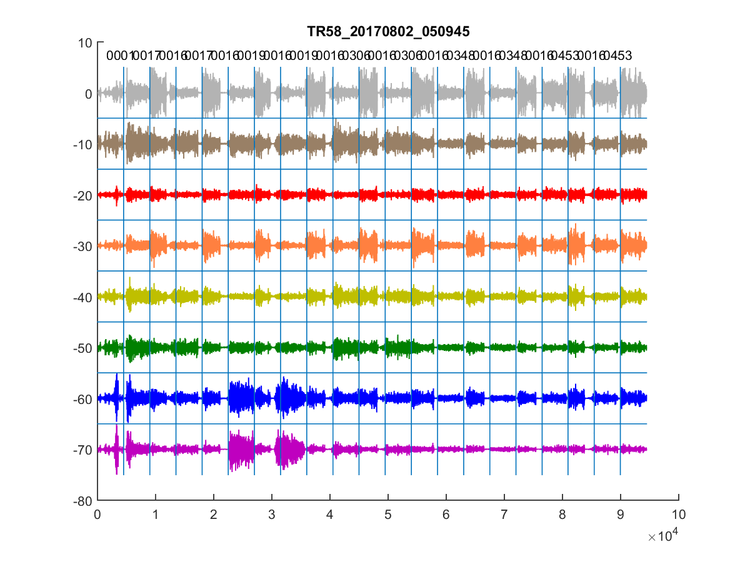
pre-TMR PR 8-week home trial

Slide 15
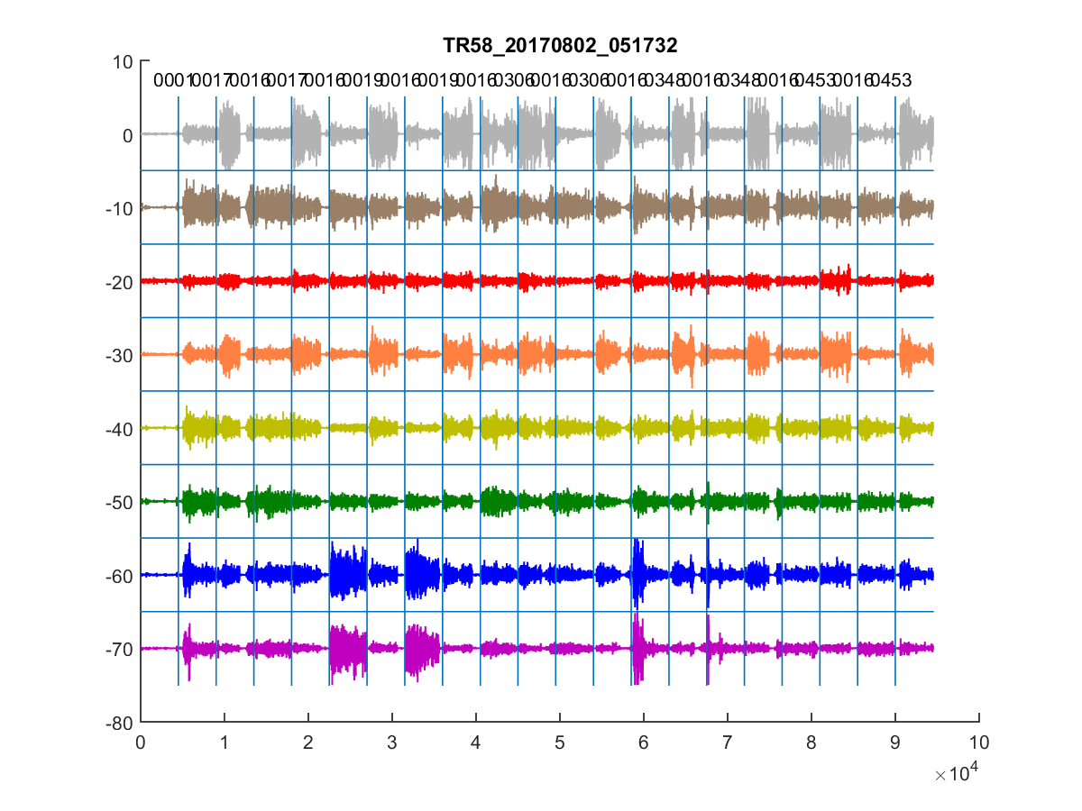
pre-TMR PR 8-week home trial

Slide 16
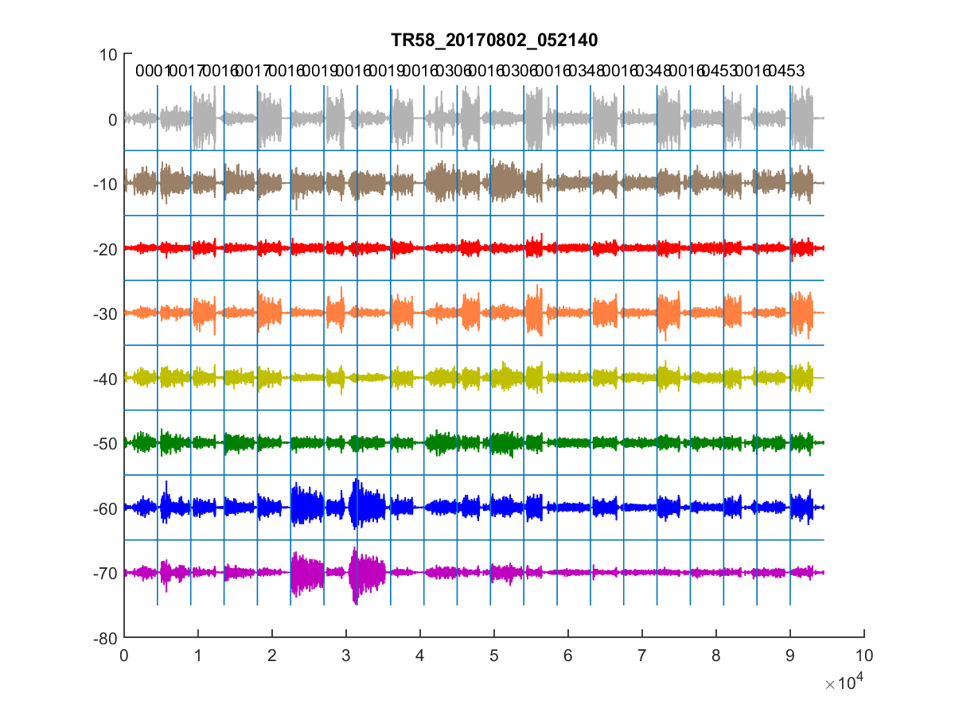
pre-TMR PR 8-week home trial

Slide 17
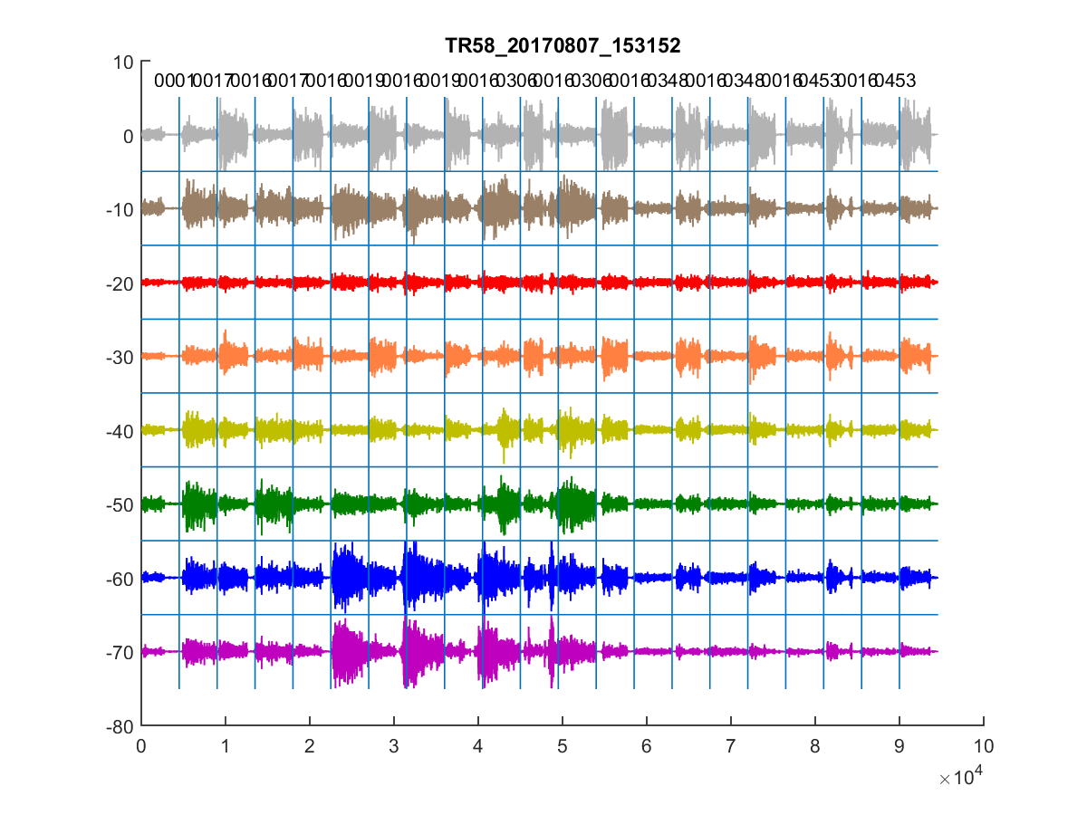
pre-TMR PR 8-week home trial

Slide 18
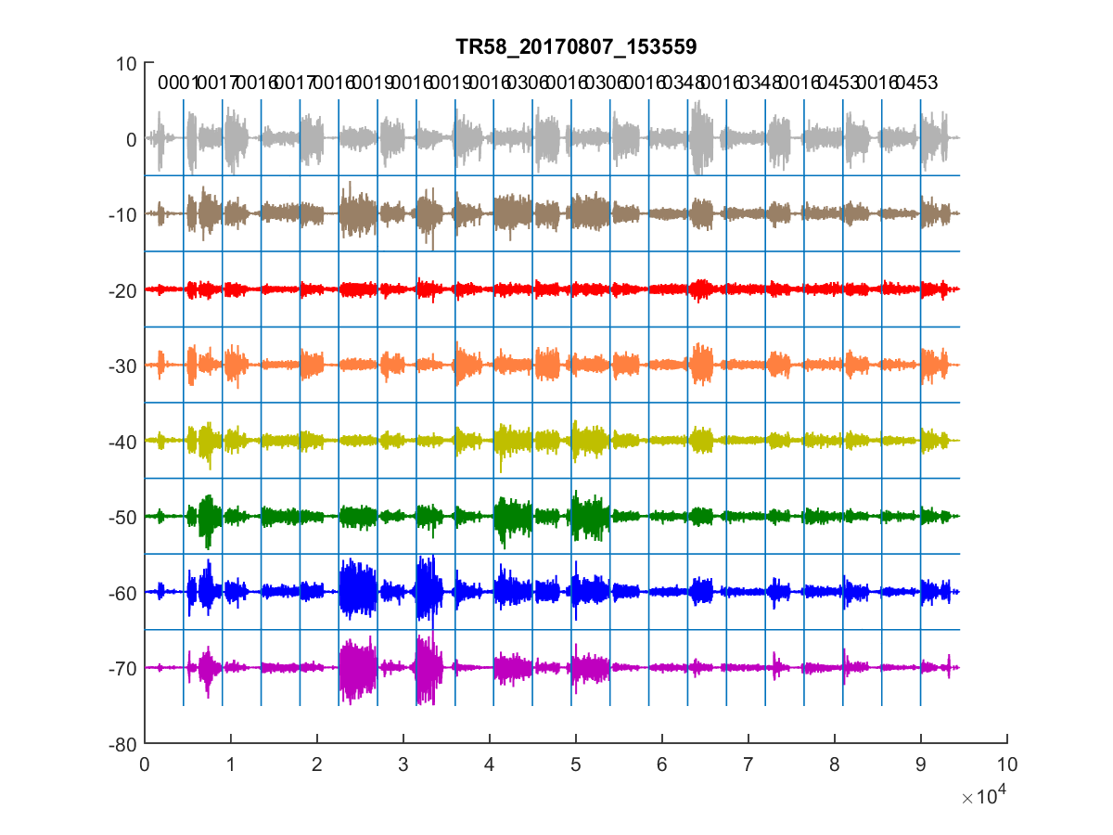
pre-TMR PR 8-week home trial

Slide 19
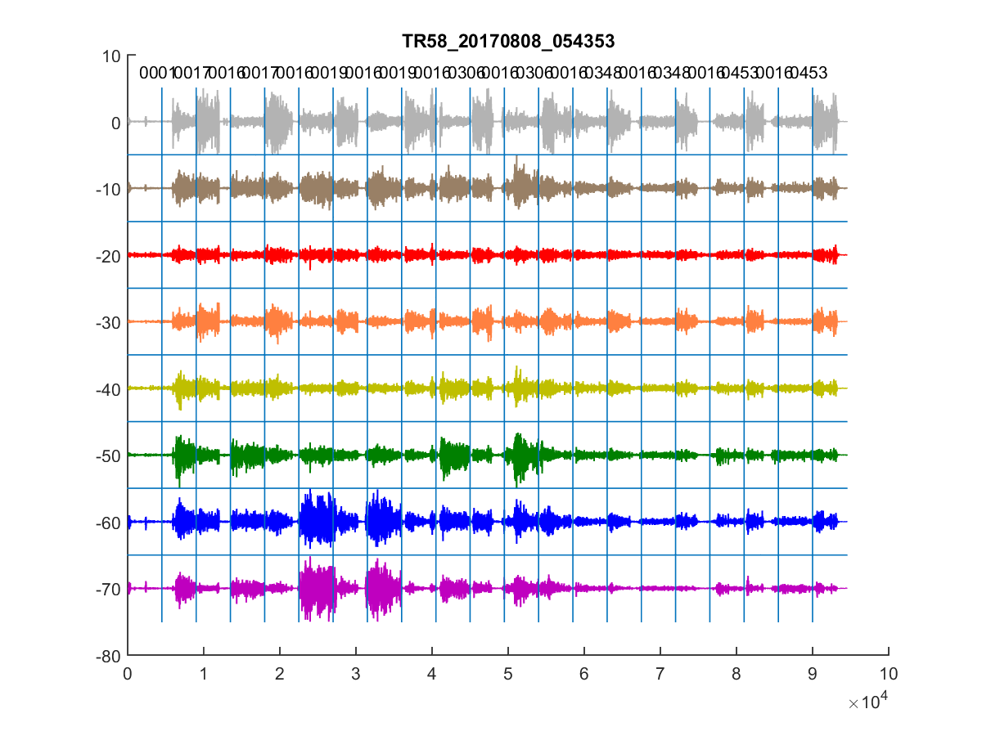
pre-TMR PR 8-week home trial

Slide 20
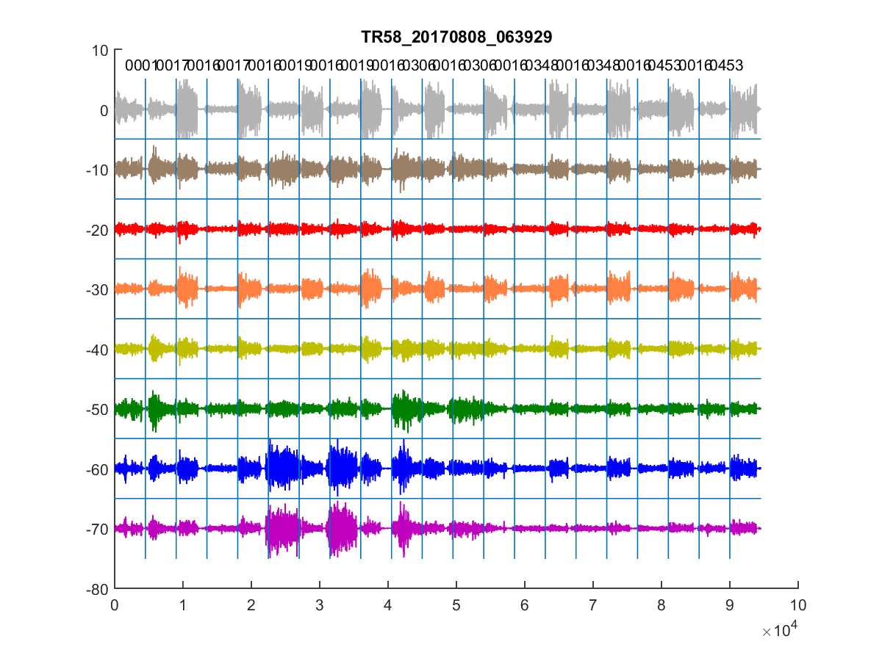
pre-TMR PR 8-week home trial

Slide 21
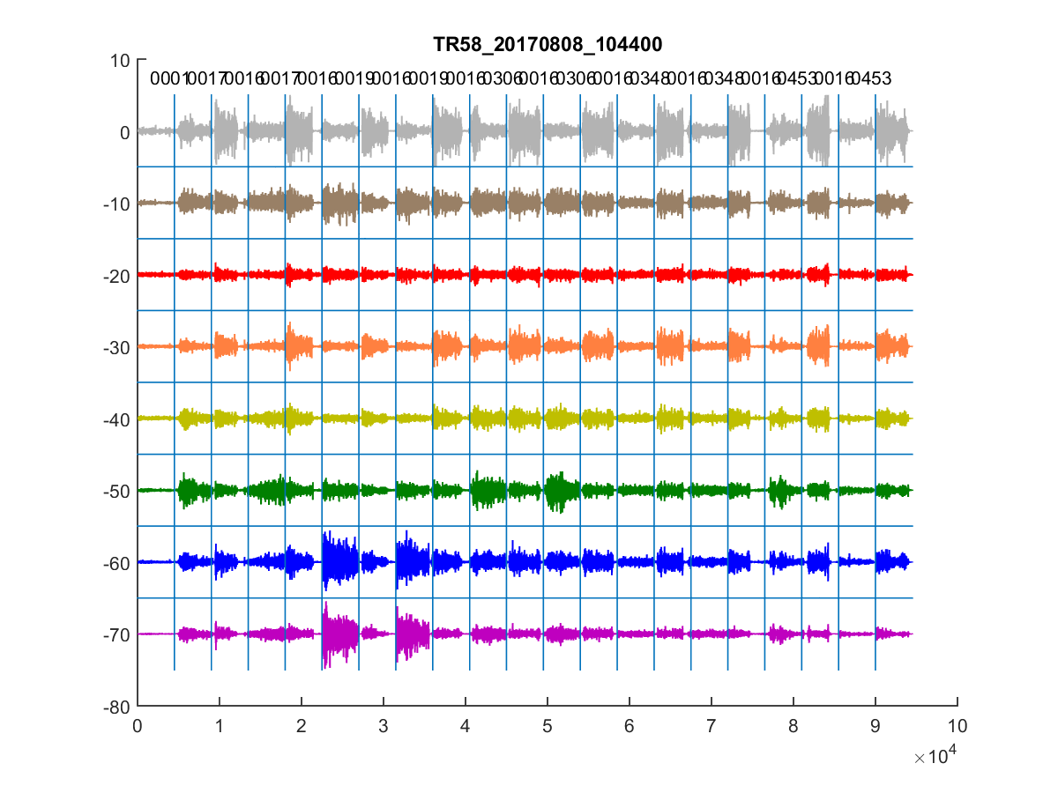
pre-TMR PR 8-week home trial

Slide 22
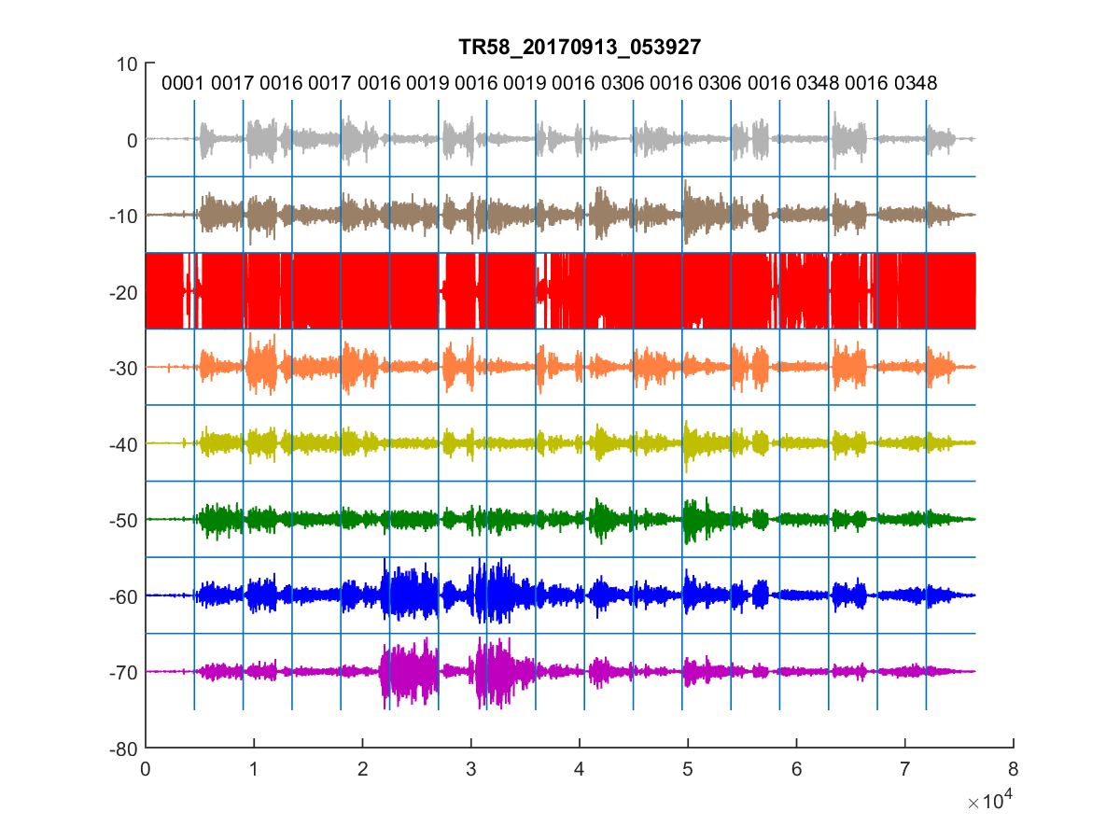
pre-TMR PR 8-week home trial
Define Signal
Issue

Slide 23
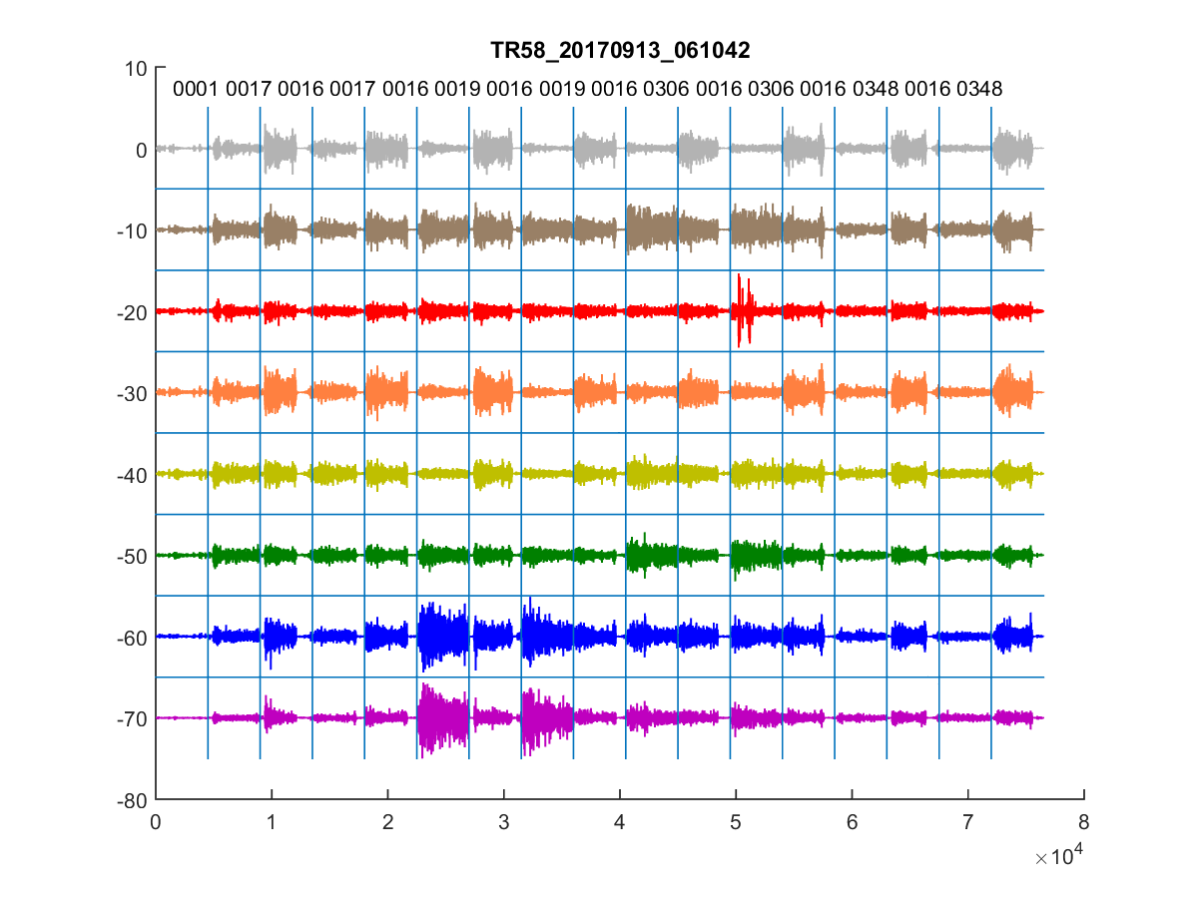
pre-TMR PR 8-week home trial

Slide 24
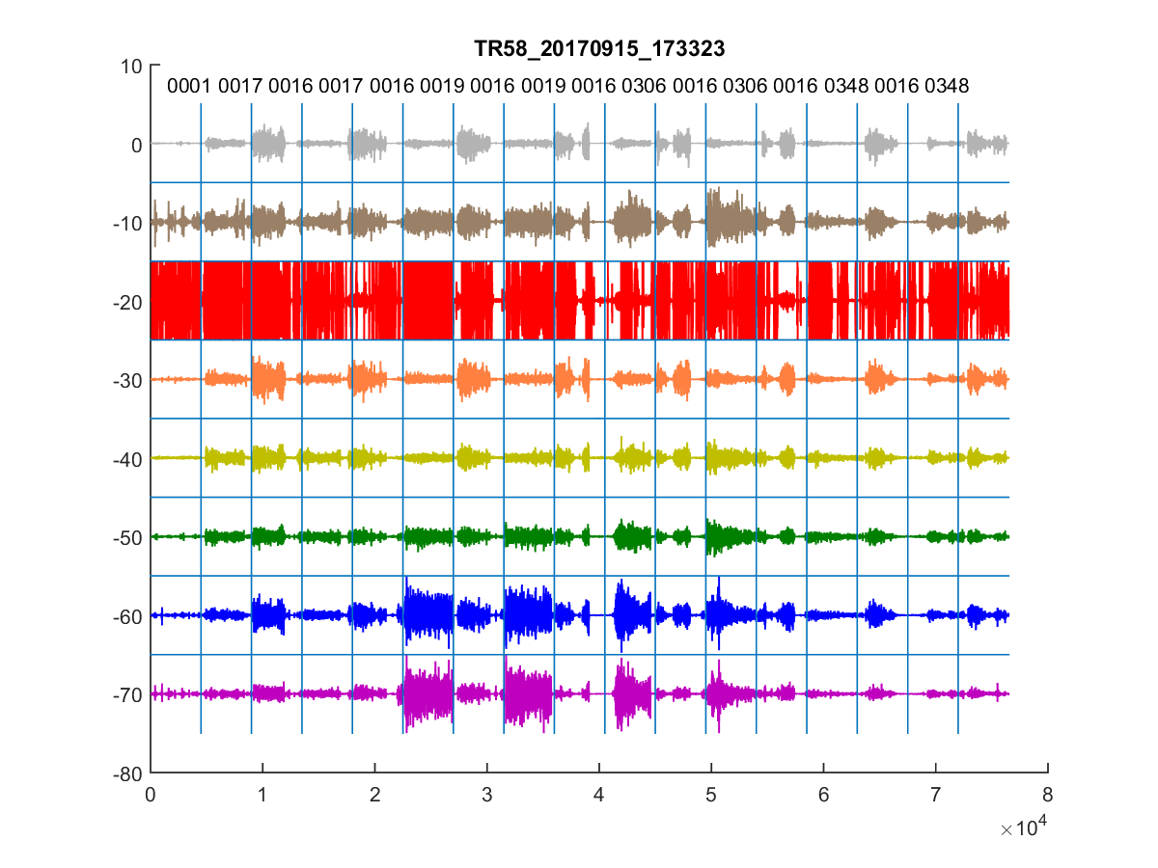
pre-TMR PR 8-week home trial
Define Signal
Issue

Slide 25
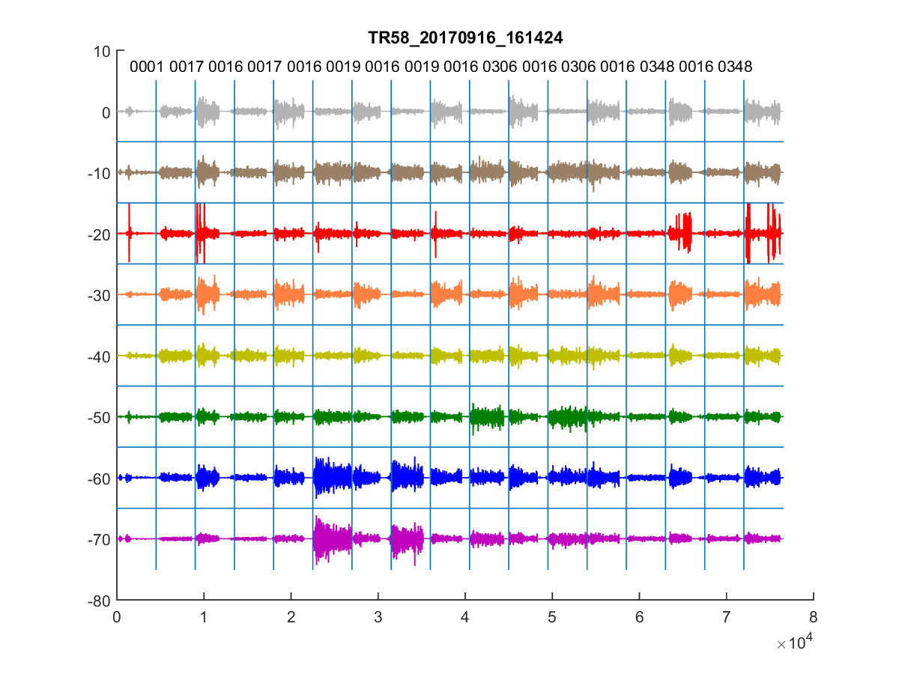
pre-TMR PR 8-week home trial

Slide 26
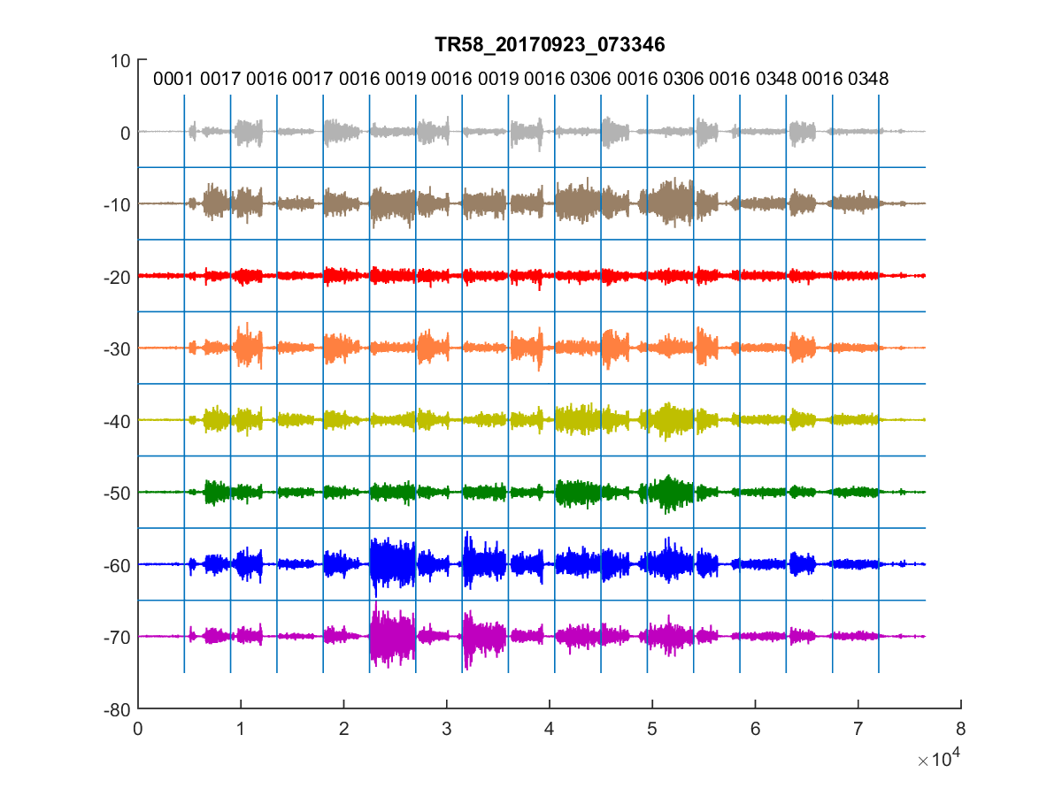
pre-TMR PR 8-week home trial

Slide 27
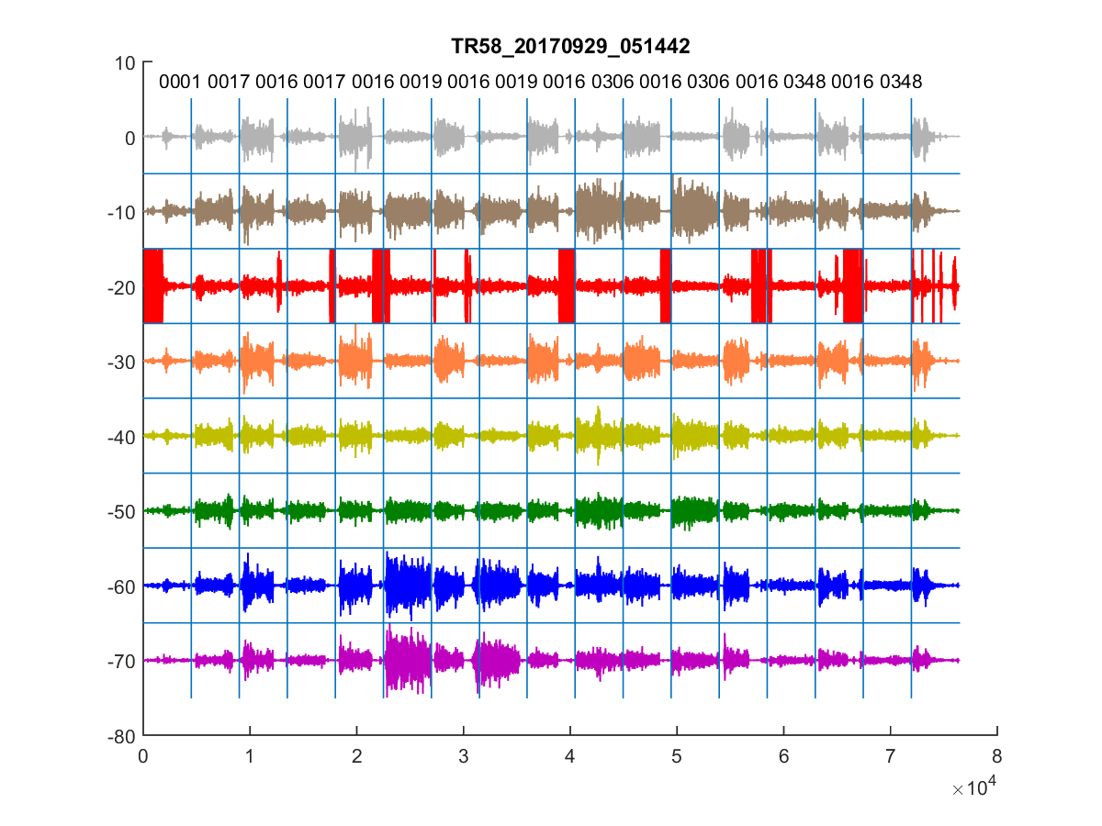
pre-TMR PR 8-week home trial
Define Signal
Issue

Slide 28
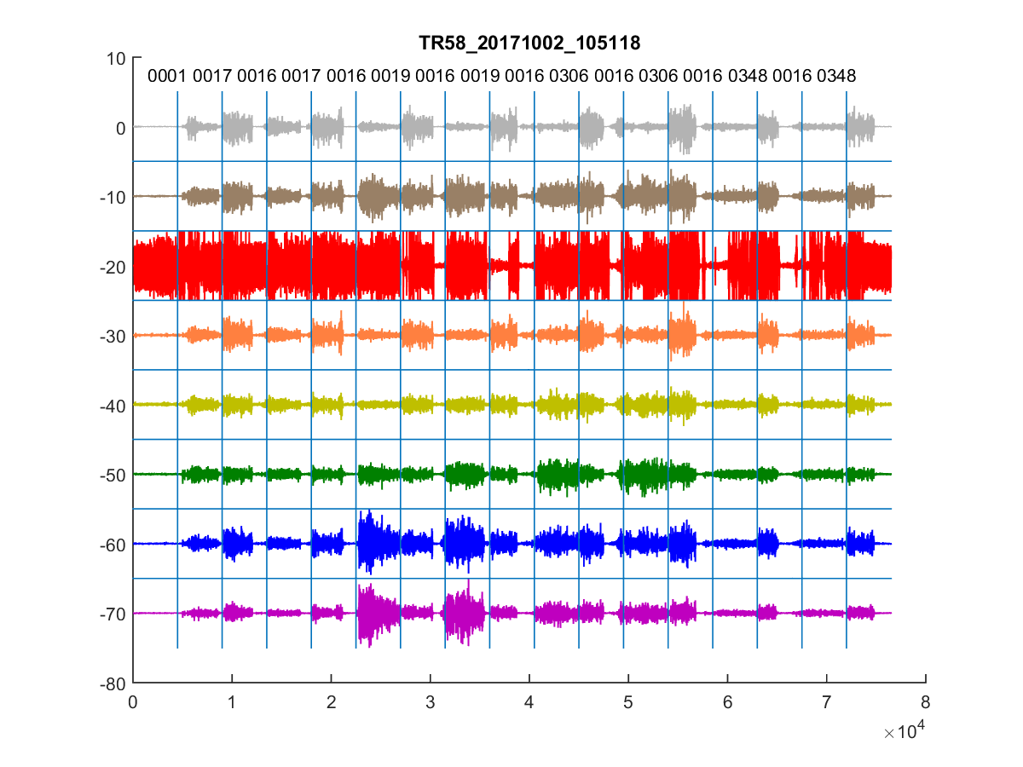
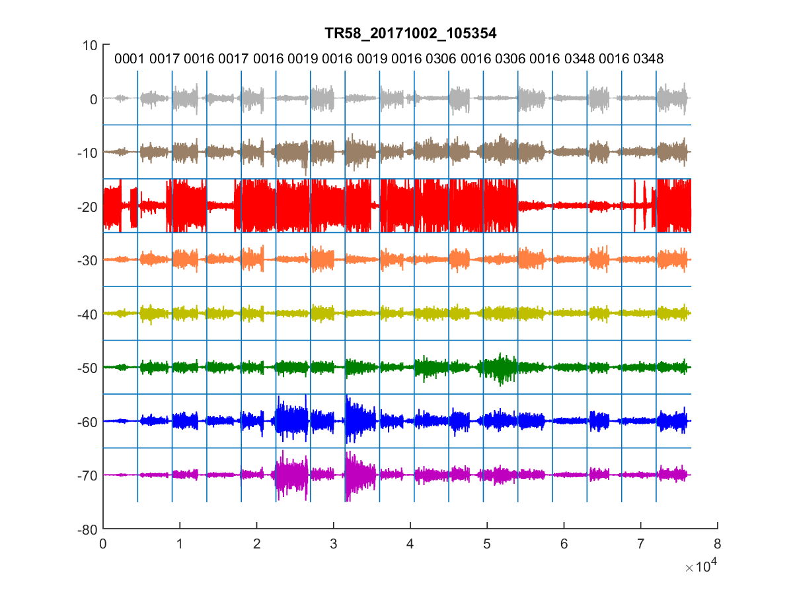
pre-TMR PR OUTCOMES

Slide 29
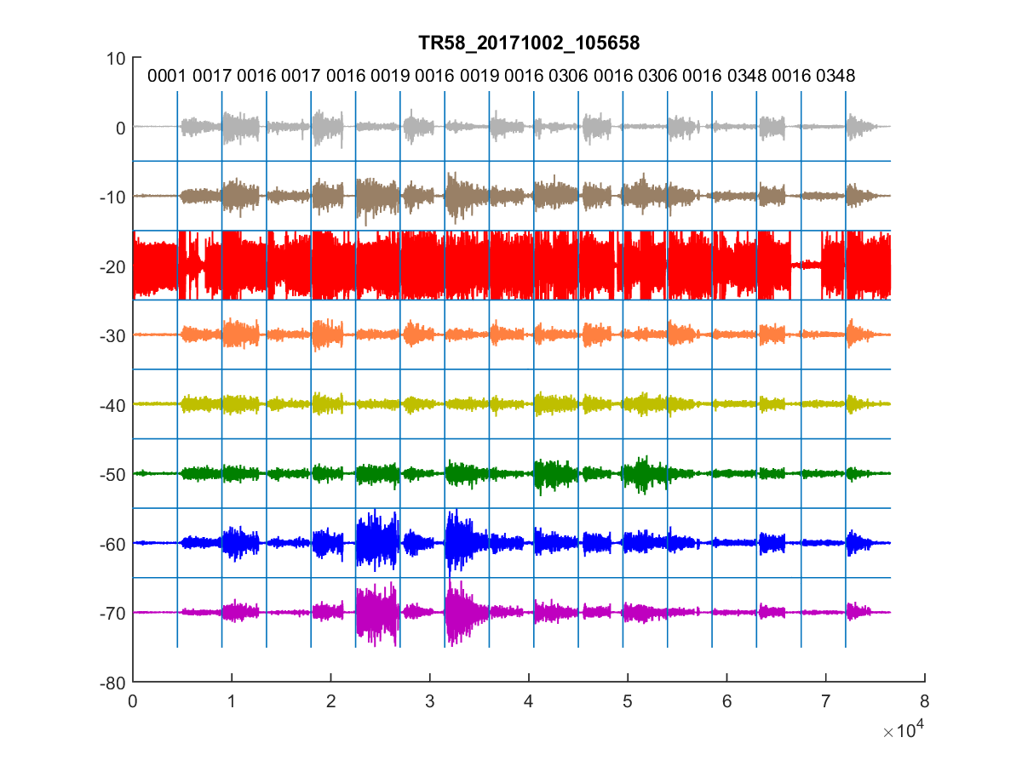
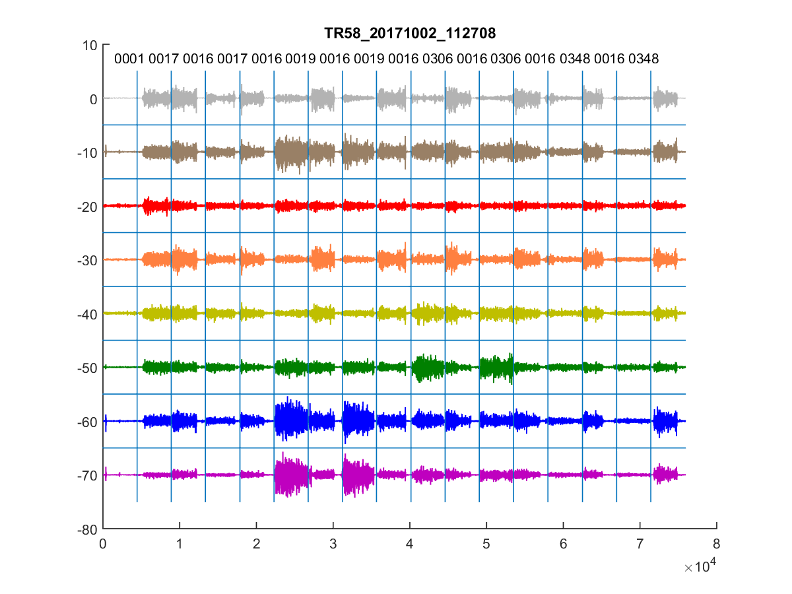
pre-TMR PR OUTCOMES

Slide 30
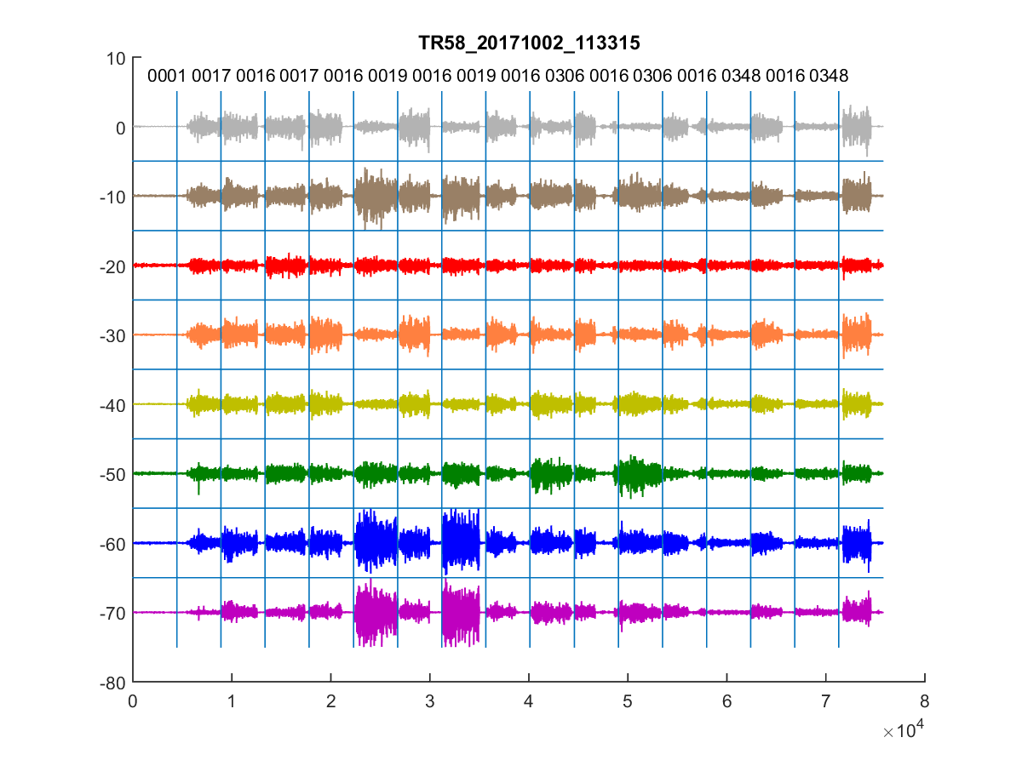
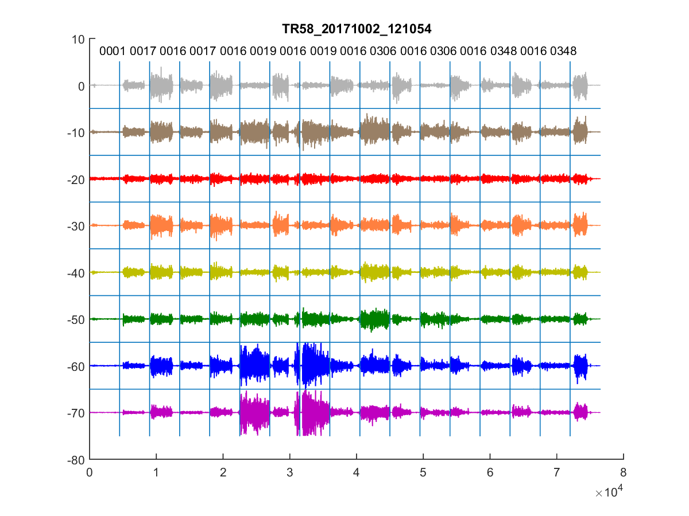
pre-TMR PR OUTCOMES

Slide 31
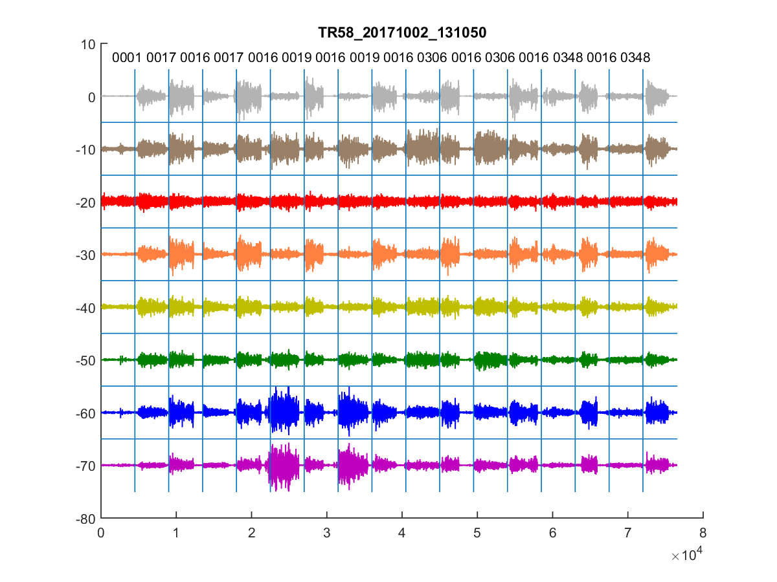
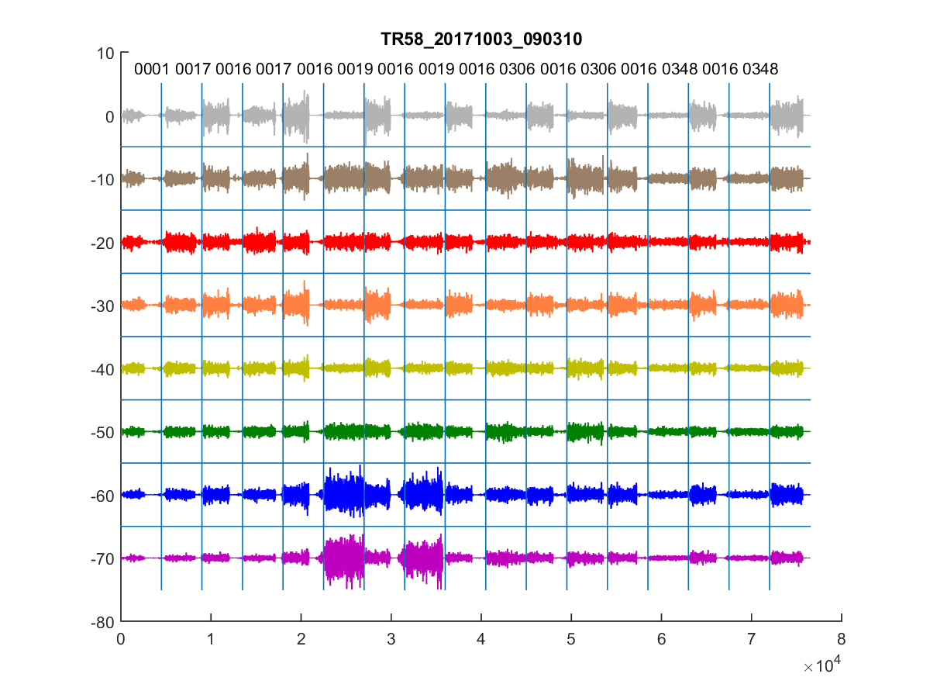
pre-TMR PR OUTCOMES

Slide 32
post-TMR PR 8-week home trial

